Slide 1
Signals
Linear Circuit Analysis II
EECE 202 – Spring 2025

Slide 2
Announcement
Project Proposal will be released next week
Form project groups.

Slide 3
Recap
Syllabus introduction
Linear Circuit Analysis I revision of important concepts
New Material
Signals

Slide 4
Learning Outcomes
2. an ability to compute responses of linear circuits with and without initial conditions via one-sided Laplace transform techniques. SO [1]

Slide 5
Basic Signals
1- Unit step function.
2- Impulse function.
3- Ramp function.

Slide 6
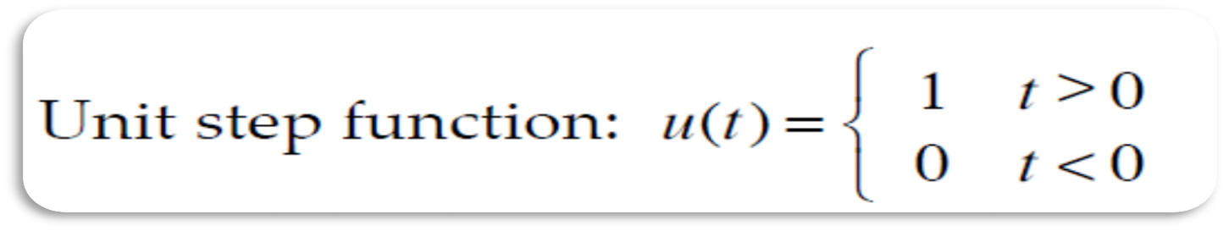
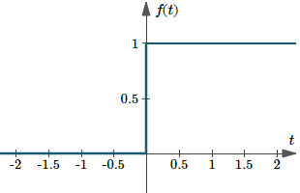
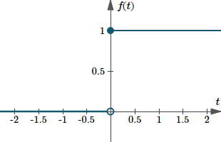
Unit Step Function
When a voltage is switched on or off in an electrical circuit at a specified value of time t.
The switching process can be described mathematically by the function called the Unit Step Function.
Notes:
And Quantitative data can also be Discrete or Continuous:
Discrete data can only take certain values (like whole numbers)
Continuous data can take any value (within a range)
Put simply: Discrete data is counted, Continuous data is measured

Slide 7


salman
Unit Step Function
When a voltage is switched on or off in an electrical circuit at a specified value of time t.
The switching process can be described mathematically by the function called the Unit Step Function.
Unit step function: u(t) = $\left\{\begin{aligned}1 t≥0 \\ 0 t<0\end{aligned}\right.$
Unit step function: u(t) = $\left\{\begin{aligned}1 t>0 \\ 0 t<0\end{aligned}\right.$
Notes:
And Quantitative data can also be Discrete or Continuous:
Discrete data can only take certain values (like whole numbers)
Continuous data can take any value (within a range)
Put simply: Discrete data is counted, Continuous data is measured

Slide 8
Shifted Step Function
f(t)=u(t-T), time-delayed unit step signal
Often represent voltages that turn on after a prescribed time period T.
Shift Right
Shift Left
+T
-T

Slide 9
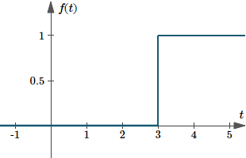

Example
Obtain the suitable function for the following graph
Shifted step:
f(t)=u(t-T)
T=3
f (t) = u(t-3)

Slide 10
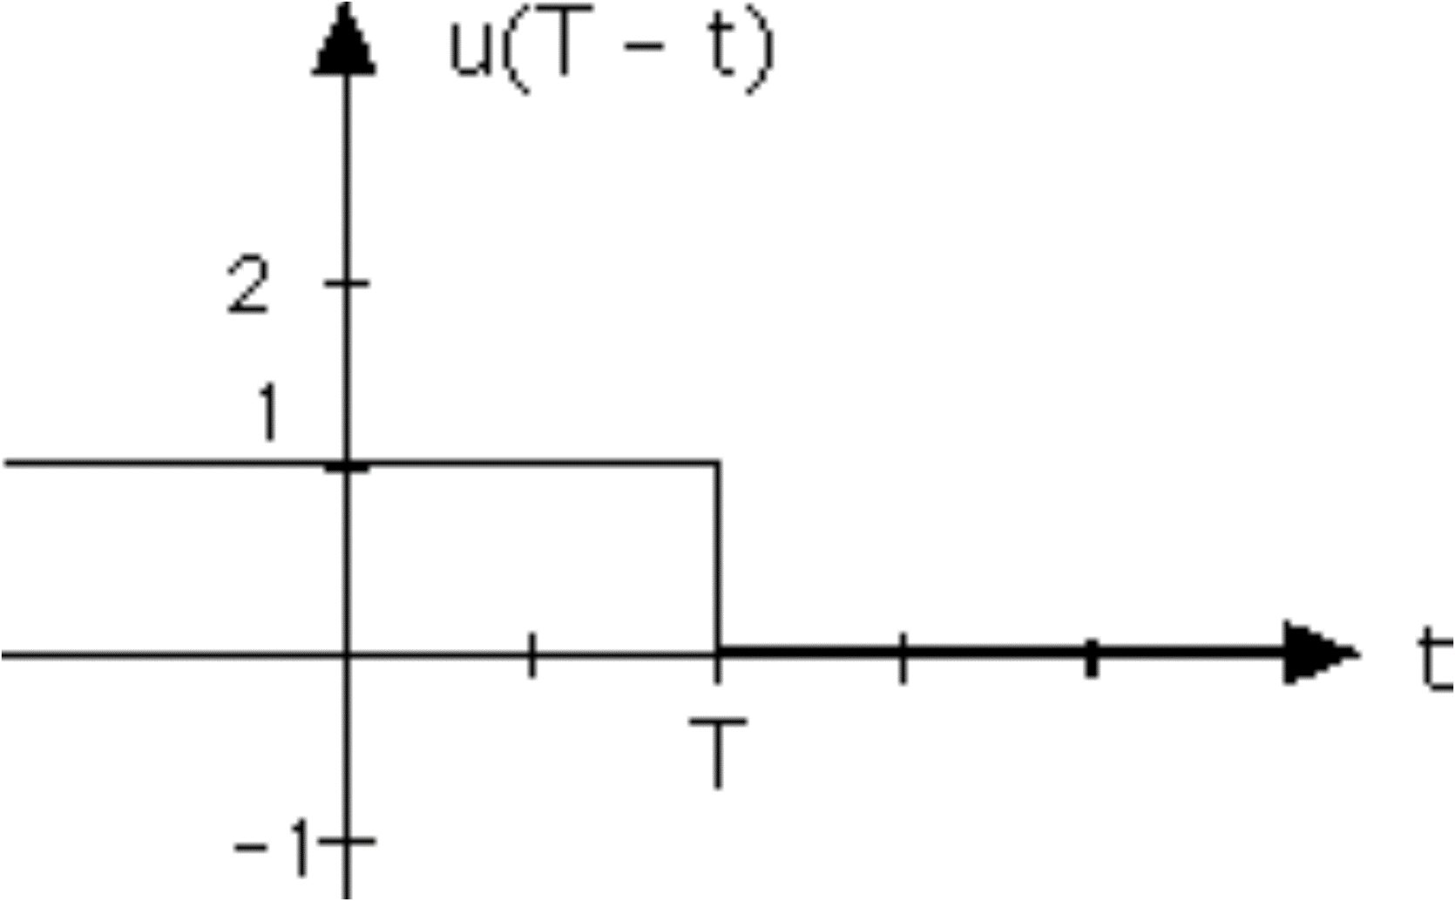
Flipped Step Function
In flipped step function, the step takes on the value of unity for time t≤T.
f(t)=u(T-t)

Slide 11
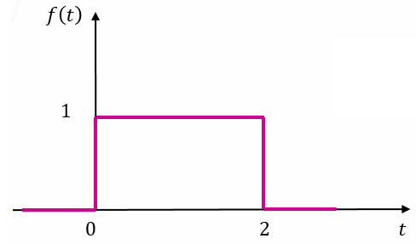
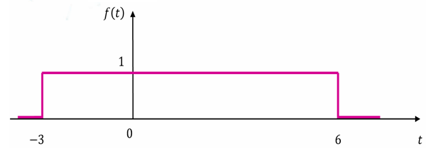
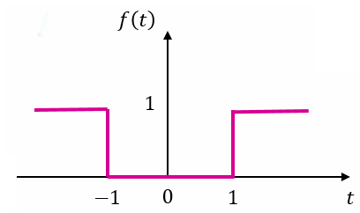
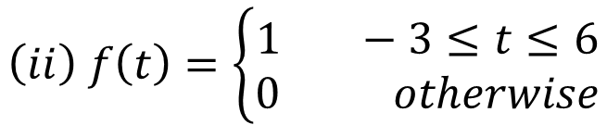
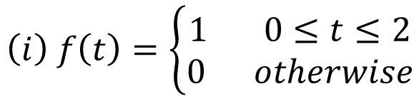
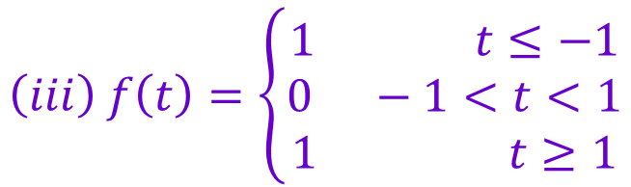
Exercise (p. 549)
Represent each of the following functions as sums of step functions:
$$\left(i\right) f\left(t\right)=\left\{\begin{aligned}1 0≤t≤2 \\ 0 otherwise\end{aligned}\right.$$
$$\left(ii\right) f\left(t\right)=\left\{\begin{aligned}1 −3≤t≤6 \\ 0 otherwise\end{aligned}\right.$$
f (t) = u(t+3)-u(t-6)
f (t) = u(t)-u(t-2)
$$\left(iii\right) f\left(t\right)=\left\{\begin{aligned}1 t≤−1 \\ 0 −1<t<1 \\ 1 t≥1\end{aligned}\right.$$
f (t) = u(-1-t)+u(t-1)

Slide 12
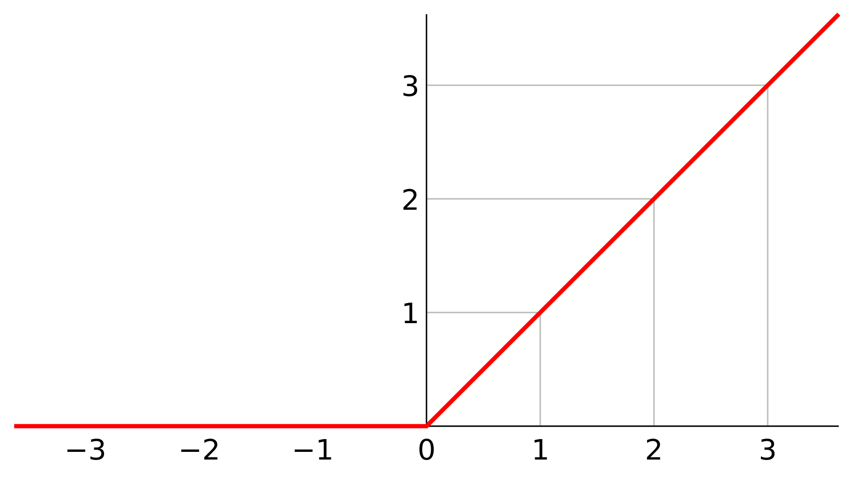

Ramp Function
A Ramp function models signals having a constant rate of increase
A Ramp function is the integral of the unit step function
$$τ is a dummy variable of integration$$

Slide 13
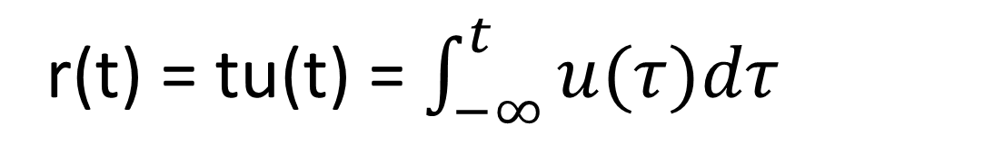
salman
Ramp Function
A Ramp function models signals having a constant rate of increase
A Ramp function is the integral of the unit step function
r(t) = tu(t) = $\int_{−∞}^{t}{u(τ)dτ}$
$$τ is a dummy variable of integration$$

Slide 14














Example 12.2 (p. 550)
Express the following figures in terms of steps and ramps
$$f\left(t\right)$$
$$f\left(t\right)$$
$$1$$
$$2$$
$$2T$$
$$2T$$
$$0$$
$$t$$
$$0$$
$$T$$
$$3T$$
$$t$$
$$T$$
$$3T$$
(a)
(b)

Slide 15


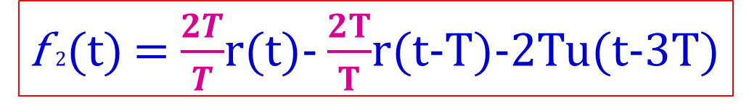
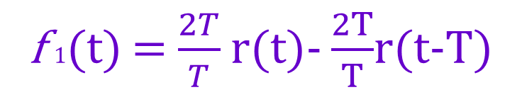












Example 12.2 (p. 550) cont.
$$f\left(t\right)$$
$$1$$
f $1$(t) = $\frac{2T}{T}$ r(t)- $\frac{2T}{T}$r(t-T)
$$2T$$
$$f\left(t\right)$$
$$2$$
$$0$$
$$T$$
$$3T$$
$$t$$
$$2T$$
f $2$(t) = $\frac{2T}{T}$r(t)- $\frac{2T}{T}$r(t-T)-2Tu(t-3T)
$$0$$
$$T$$
$$3T$$
$$t$$

Slide 16
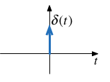
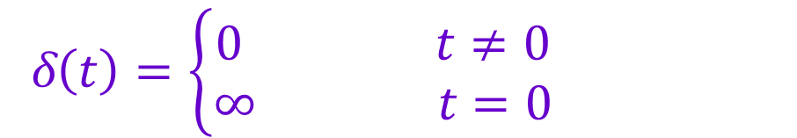
Impulse Function
The Impulse function is also named Delta Function (δ(t))
δ$\left(t\right)=\left\{\begin{aligned}0 t≠0 \\ ∞ t=0\end{aligned}\right.$
The delta function has infinite height, zero width, and a well defined area of 1 unit

Slide 17

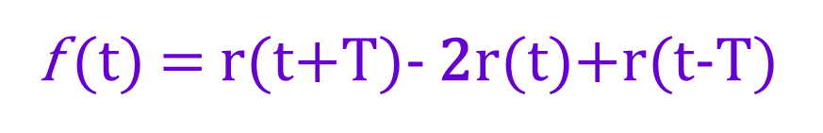





Example 12.3 (p. 551)
$$f\left(t\right)$$
$$T$$
f (t) = r(t+T)- 2r(t)+r(t-T)
$$−T$$
$$0$$
$$T$$
$$t$$

Slide 18





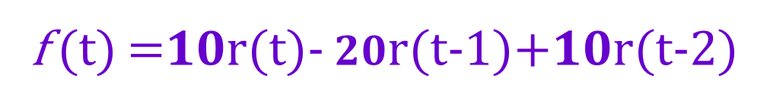






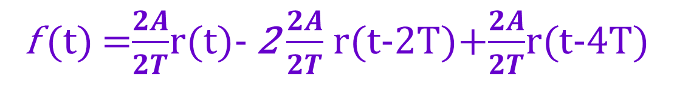

Exercise 8 (p. 593 (a) )
Represent f (t ) as a sum as steps, ramps, shifts of basic signals
$$f\left(t\right)$$
$$10$$
f (t) =$10$r(t)- $20$r(t-1)+$10$r(t-2)
$$t$$
$$0$$
$$1$$
$$2$$
$$f\left(t\right)$$
f (t) =$\frac{2A}{2T}$r(t)- 2 $\frac{2A}{2T}$ r(t-2T)+$\frac{2A}{2T}$r(t-4T)
$$2A$$
$$t$$
$$0$$
$$2T$$
$$4T$$

Slide 19

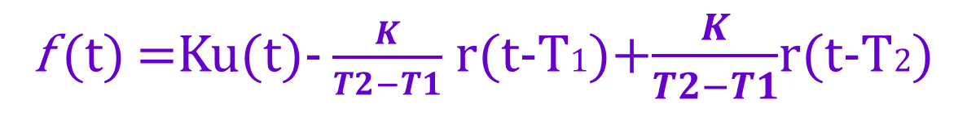

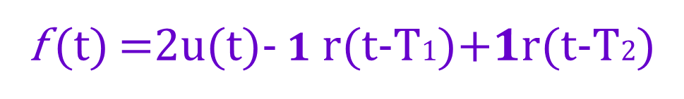






Exercise 10 (p. 594 (b) )
Represent f (t ) as a sum as steps, ramps, shifts of basic signals
f (t) =Ku(t)- $\frac{K}{T2−T1}$ r(t-T1)+$\frac{K}{T2−T1}$r(t-T2)
$$f\left(t\right)$$
$$2$$
1
f (t) =2u(t)- $1$ r(t-T1)+$1$r(t-T2)
$$0$$
$$1$$
$$2$$
$$3$$
$$4$$
$$t$$

Slide 20
Additional example 1
Represent f (t ) as a sum as steps, ramps, shifts of basic signals
f (t ) = 3u(t )+ u(t −1)− 2u(t − 2)− u(t − 3)− u(t − 4)

Slide 21
Example 2
Represent f₄ (t ) as a sum as steps, ramps, shifts of basic signals
f4(t ) = 2t u(t )- 2(t −2) u(t − 2)− 2(t − 6) u(t − 6)+2(t-7)u(t-7)

Slide 22
Practice
Use ChatGPT to answer following:
Explain the Unit Step Function and its significance in circuit analysis.
What is a flipped step function, and how is it different from the standard unit step function?
Define the ramp function and explain its relationship with the unit step function.
What is the impulse function, and how does it differ from the unit step function?

Slide 23
Summary
Unit Step Function
Describes voltage switching on/off in a circuit
Example: f(t)=u(t−T)
Ramp Function
Models signals with constant increase rate
Integral of the Unit Step Function
Impulse (Delta) Function
Represents an instantaneous change in signal with zero width and infinite height
Shifted and Flipped Step Functions
Shifted Step: f(t)=u(t−T)
Flipped Step: f(t)=u(T−t)
Signal Composition
Representing complex functions using sums of steps, ramps, and shifts
Example: f(t)=r(t) - 2r(t-2T) + r(t-4T)f(t)=r(t)−2r(t−2T)+r(t−4T)
Suggested Additional Problems for Ch. 12:
Exercise 8 (p. 593 (b) ), 10 (p. 594 (a) ), 7

